Slide 1
Chapter 5: Dynamic Analysis-Test Design Techniques
Software Testing
Cause Effect Graph Testing

Slide 2
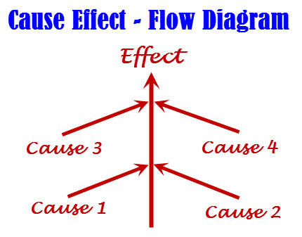
Cause Effect Graph Testing
Black box testing technique
Testing technique logically relate causes to effects
Causes are the input conditions and effects are the results
Cause represents
- Distinct input condition
Effects represents
- output condition
CEG is useful for generating a reduced decision table
Goal is to reduce total number of test cases

Slide 3
Steps for Cause-Effect Graph Testing
Recognize and describe the input conditions (causes) and actions (effect)
Build up a cause-effect graph
Convert cause-effect graph into a decision table
Convert decision table rules to test cases.

Slide 4
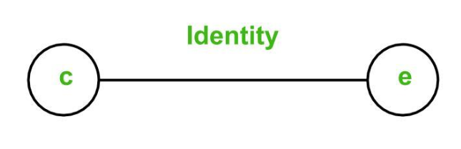
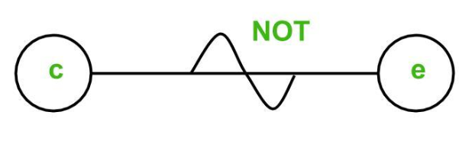
Basic Notations used in Cause-effect graph
Here c= cause, e=effect, 0 = absent state, 1= present state
Following notations can be used:
Identity Function: if c is 1, then e is 1. Else e is 0
NOT Function: if c is 1, then e is 0. Else e is 1.
c | e
1 | 1
c | e
0 | 1

Slide 5
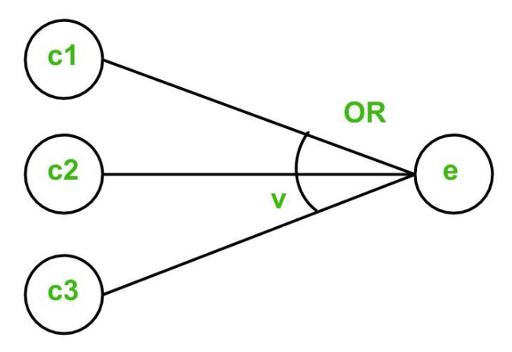
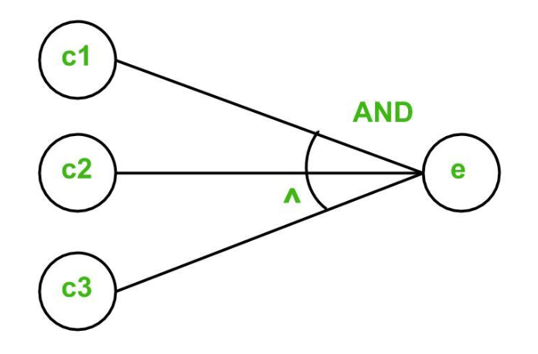
Basic Notations used in Cause-effect graph
OR Function: if c1 or c2 or c3 is 1, then e is 1. Else e is 0
AND Function: if both c1 and c2 and c3 is 1, then e is 1. Else e is 0.
c1 | c2 | e
0 | 1 | 1
1 | 0 | 1
1 | 1 | 1
c1 | c2 | e
1 | 1 | 1

Slide 6
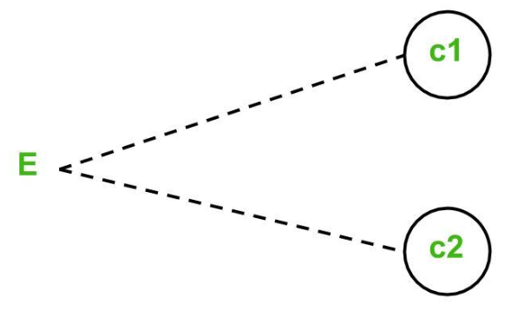
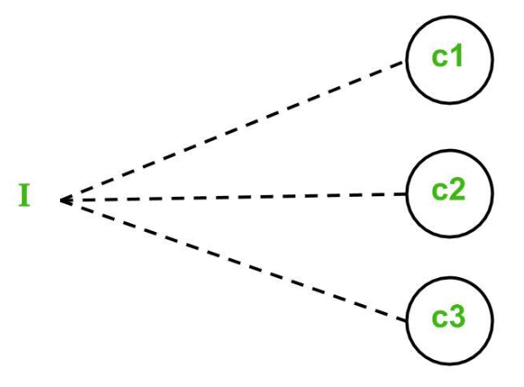
Basic Notations used in Cause-effect graph
Impossible combinations will use constraints which are:
Exclusive constraint or E-constraint: This constraint exists between causes. It states that either c1 or c2 can be 1, i.e., c1 and c2 cannot be 1 simultaneously. (Only one of the causes can be true) e.g payment through cash or check
Inclusive constraint or I-constraint: This constraint exists between causes. It states that atleast one of c1, c2 and c3 must always be 1, i.e., c1, c2 and c3 cannot be 0 simultaneously. e.g multi authentication system in mobile like passcode, face login, or finger.
C1 | C2
0 | 0
0 | 1
1 | 0
C1 | C2 | C3
1 | 1 | 1
1 | 0 | 0
0 | 1 | 0
0 | 0 | 1

Slide 7
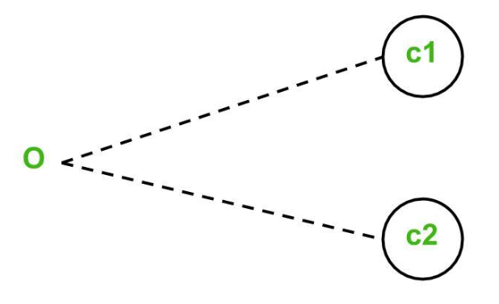
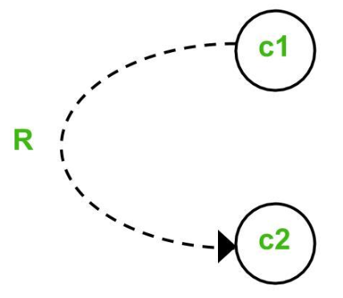
Basic Notations used in Cause-effect graph
One and Only One constraint or O-constraint: This constraint exists between causes. It states that one and only one of c1 and c2 must be 1.
Requires constraint or R-constraint: This constraint exists between causes. It states that for c1 to be 1, c2 must be 1. It is impossible for c1 to be 1 and c2 to be 0.
C1 | C2
0 | 1
1 | 0
C1 | C2
1 | 1
0 | 0

Slide 8
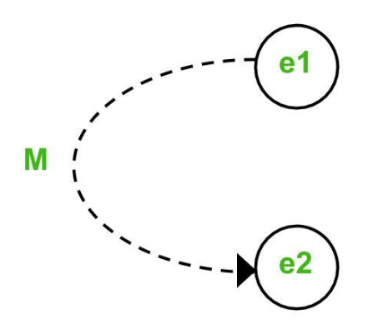
Basic Notations used in Cause-effect graph
Mask constraint or M-constraint: This constraint exists between effects. It states that if effect e1 is 1, the effect e2 is forced to be 0.

Slide 9
Example
The “Print message” is software that read two characters and, depending on their values, messages must be printed.
The first character must be an “A” or a “B”.
The second character must be a digit.
If the first character is an “A” or “B” and the second character is a digit, the file must be updated.
If the first character is incorrect (not an “A” or “B”), the message X must be printed.
If the second character is incorrect (not a digit), the message Y must be printed.

Slide 10
Example
The causes for this situation are: C1 – First character is A C2 – First character is B C3 – the Second character is a digit
The effects (results) for this situation are E1 – Update the file E2 – Print message “X” E3 – Print message “Y”

Slide 11
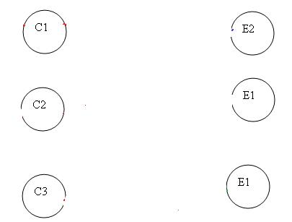
Example
First, draw the causes and effects as shown below:
Note – Always go from effect to cause. That means, to get effect “E”, what causes should be true.
3

Slide 12
Example
In this example, let’s start with Effect E1.
Effect E1 is to update the file. The file is updated when – The first character is “A” and the second character is a digit – The first character is “B” and the second character is a digit – The first character can either be “A” or “B” and cannot be both.
Now let’s put these 3 points in symbolic form:

Slide 13
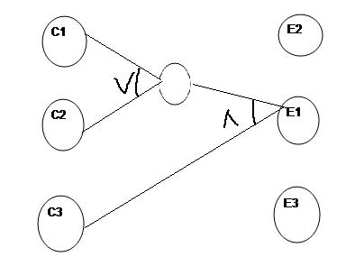
Example
For E1 to be true – following are the causes: – C1 and C3 should be true – C2 and C3 should be true – C1 and C2 cannot be true together. This means C1 and C2 are mutually
exclusive.
Now let’s draw this:

Slide 14
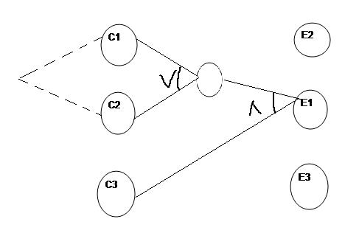
Example
So as per the above diagram, for E1 to be true the condition is (C1 V C2) ꓥ C3
The circle in the middle is just an interpretation of the middle point to make the graph less messy.
There is a third condition where C1 and C2 are mutually exclusive. So the final graph for effect E1 to be true is shown below:

Slide 15
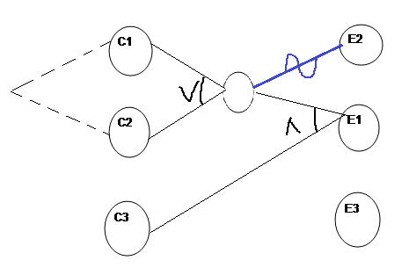
Example
For Effect E2: E2 states to print message “X”. Message X will be printed when the First character is neither A nor B. Which means Effect E2 will hold true when either C1 OR C2 is invalid. So the graph for Effect E2 is shown as (In blue line)

Slide 16
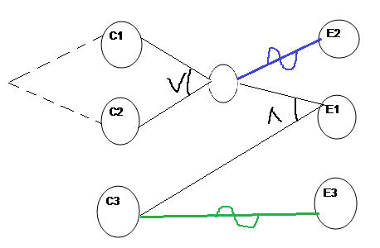
Example
For Effect E3. E3 states to print message “Y”. Message Y will be printed when Second character is incorrect(not digit). Which means Effect E3 will hold true when C3 is invalid. So the graph for Effect E3 is shown as (In Green line)
E

Slide 17
Example-Decision table from Graph
The graph must be transformed into a ➞decision table from which the test cases can be derived. The steps to transform a graph into a table are as follows:
Choose an effect.
Looking in the graph, find combinations of causes that have this effect and combinations that do not have this effect.
Add one column into the table for every one of these cause-effect combinations. Include the caused states of the remaining effects.
Check to see if decision table entries occur several times, and if they do, delete them.

Slide 18

Decision table based on Cause Effect graph
First, write down the Causes and Effects in a single column shown below
Key is the same. Go from bottom to top which means traverse from effect to cause.

Slide 19

Example
Start with Effect E1. For E1 to be true, the condition is (C1 V C2) ꓥ C3 Here we are representing True as 1 and False as 0
First, put Effect E1 as True in the next column as

Slide 20
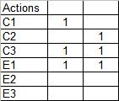
Example
Now for E1 to be “1” (true), we have the below two conditions – C1 AND C3 will be true C2 AND C3 will be true

Slide 21
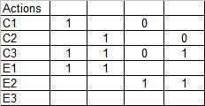
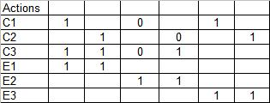
Example
For E2 to be True, either C1 or C2 has to be false shown as
For E3 to be true, C3 should be false.
0
0

Slide 22
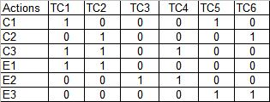
Example
So it’s done. Let’s complete the graph by adding 0 in the blank column and including the test case identifier.

Slide 23
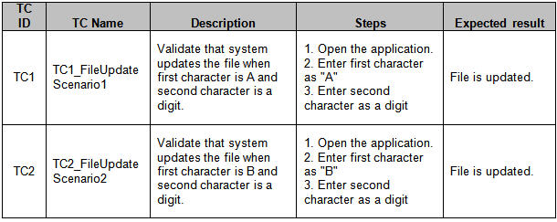
Example
Writing Test cases from the decision table
I am writing a sample test case for test case 1 (TC1) and Test Case 2 (TC2).
Similarly, you can create other test cases.

Slide 24
Example 2: ATM CEG
In the following example, we’ll use the act of withdrawing money at an automated teller machine (ATM) to illustrate how to prepare a cause-effect graph. In order to get money from the machine, the following conditions must be fulfilled:
The bank card is valid.
The PIN is entered correctly.
The maximum number of PIN inputs is three.
There is money in the machine and in the account.
The following actions are possible at the machine:
Reject card.
Ask for another PIN input.
“Eat” the card.
Ask for an other amount.
Pay the requested amount of money.

Slide 25
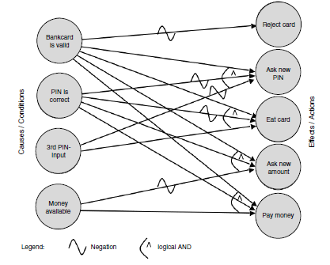
Example 2: ATM CEG
Fig. Cause Effect Graph of ATM

Slide 26
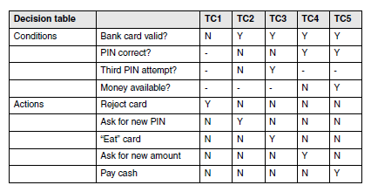
Example 2: ATM CEG
Decision Table for ATM

Slide 27
Thank you

